Slide 1
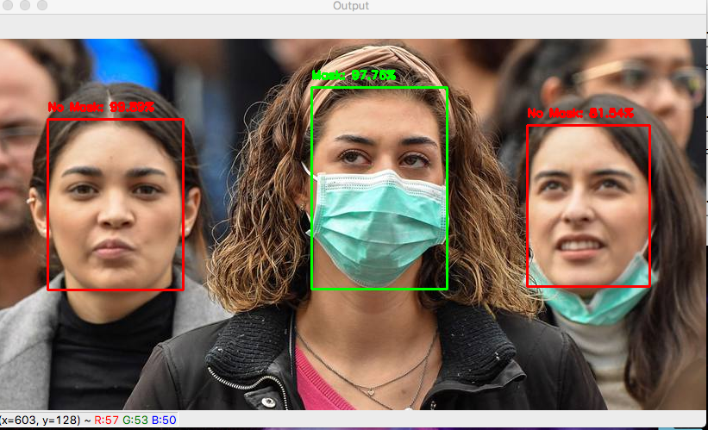
FACE MASK DETECTION
Submitted by: Chandrika Deb
GitHub Username: chandrikadeb7

Slide 2
Aim
This project intends to develop a Face Mask Detection system using OpenCV, Keras/TensorFlow and Deep Learning.
The system can be easily integrated to various embedded devices with limited computational capacity as it uses MobileNetV2 architecture.
It will detect face masks in images as well as in real-time videos.
The model is expected to give an accuracy of 90% and above.

Slide 3


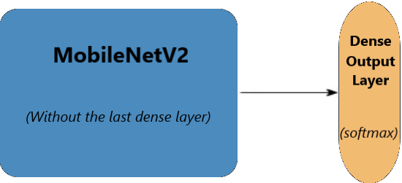



Tech/Framework

Slide 4
Dataset
This dataset consists of 3835 images belonging to two classes:
with_mask: 1916 images
without_mask: 1919 images
The images used were real images of faces wearing masks. The images were collected from the following sources:
Bing Search API
Kaggle datasets
RMFD dataset

Slide 5
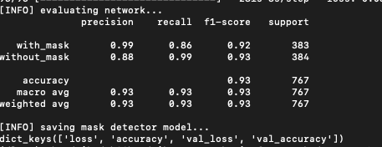
Results
We get 93% accuracy on our mask detection model

Slide 6
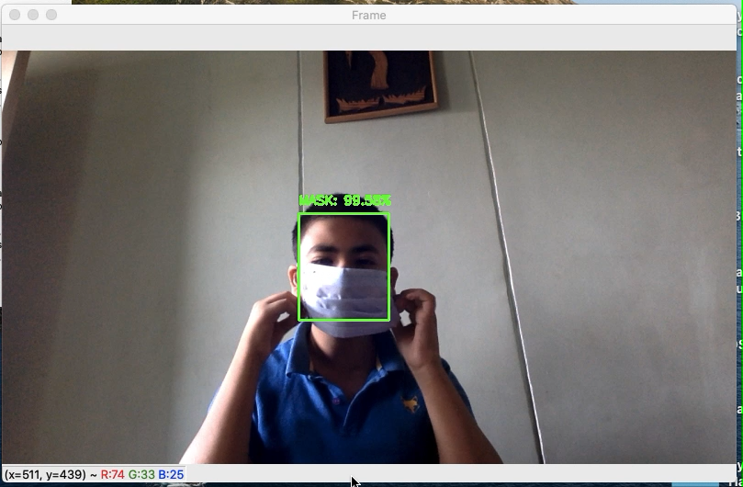
Demo Video

